Slide 1

— Who Survived —
TITANIC
— Tragedy —
Tableau presentation

Slide 2
— Titanic ship voyage —
Embarkment ports
Southampton
Cherbourg
Queenstown
41c 43.5’N 49° 56.8’W

Slide 3
— Timeline of ship tragedy events, April 1912 —
Hits iceberg
Lifeboats lowered
Lights go out
11.40 pm
00.30 am
2.10 am

Slide 4
— Timeline of ship tragedy events II, April 1912 —
Breaks in two
Boat sinks
Hits the bottom
2.17 am
2.19 am
2.24 am

Slide 5
882 ft
1,517
28°F
1,451 miles
Titanic’s length
Titanic’s distance travelled
Lives were lost
The ocean’s temperature

Slide 6
— Who Survived Titanic Tragedy Introduction —
This is an interactive Tableau story that narrates the analysis of Titanic passenger data, exploring survival patterns and demographics

Slide 7
— Titanic story points—
1.
3.
Passenger Demographics
Passenger Age & Fare Analysis
2.
4.
Survival Analysis
Survivor Geography
Overview of passenger characteristics
Survival rates by gender
Class distribution by embarkation port
Survival patterns across passenger classes
Initial demographic breakdown
Family size impact on survival
Age group survival analysis
Survival rates by gender
Geographic visualization of embarkation port
Survival patterns across passenger classes
Survival rates by embarkation location
Family size impact on survival
Map-based analysis of passenger origin
Age group survival analysis
5.
Survivor List
Detailed list of survivors by embarkation port
Survivor counts and percentages
Comprehensive survivor breakdown

Slide 8
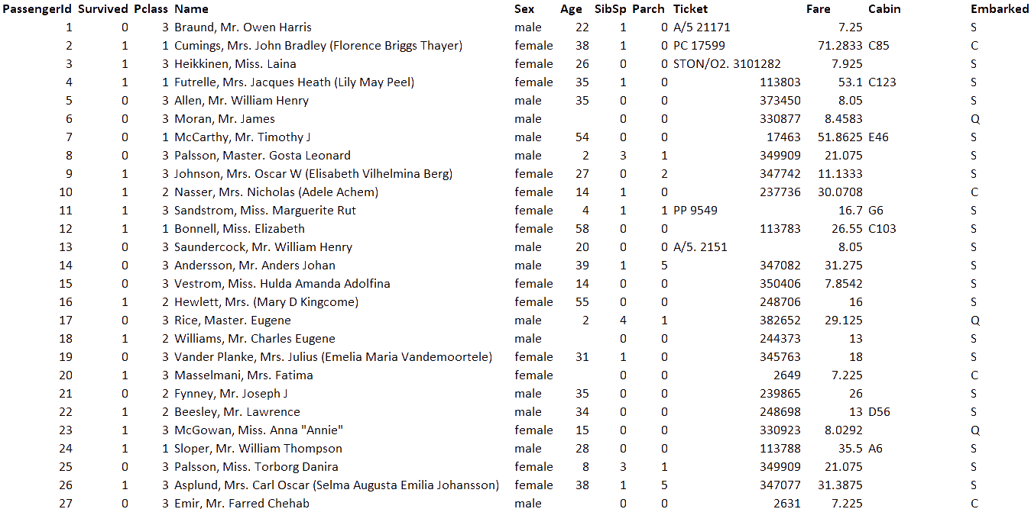
— Data for Titanic story —

Slide 9

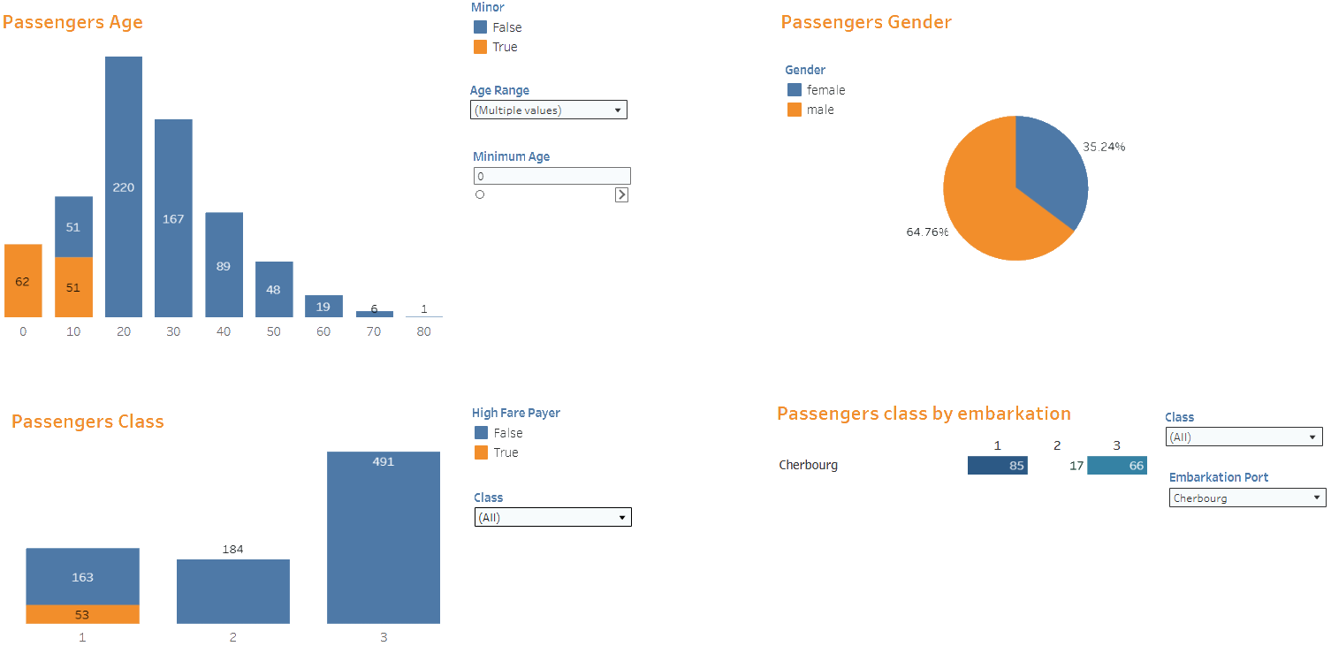
1.
Passenger Demographics

Slide 10
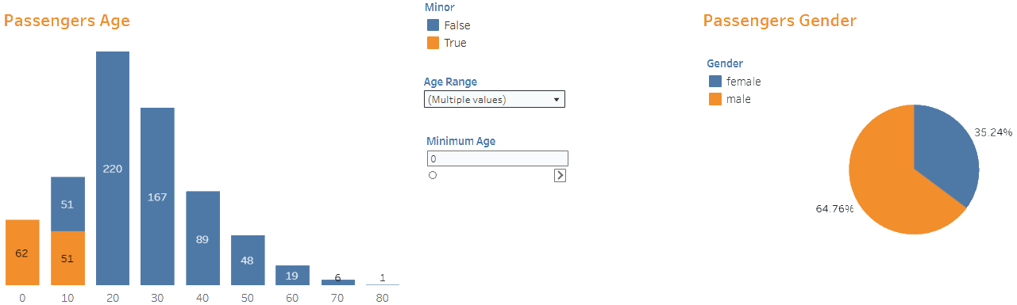
1.
Passenger Demographics
Bar chart offers passenger age breakdown: 0-80
Pie chart offers passenger gender breakdown
Minors (less than 18) are displayed in orange
Males are displayed in orange, females – in blue
Most of passengers were between 20-30 years old
Most of passengers were males: almost 65%
Age Range filter allows to view people only of certain age group
There were 35% females on the ship
With Minimum Age filter you can set the starting age of passengers to be displayed

Slide 11
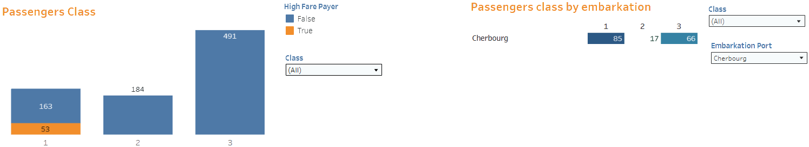
1.
Passenger Demographics
Bar chart offers passenger fare class breakdown: 1-3
Highlighted table offers passenger fare class breakdown by embarkation port
High fair payers (more than $100) are displayed in orange
Most of passengers purchased 3d class tickets
53 passengers in 1st class were high fair payers
Most people boarded in Cherbourg (85) purchased 1st class tickets
Embarkation Port dropdown filters passengers by port: Cherbourg, Queenstown, or Southampton
Class filter allows displaying passengers who purchased tickets of only certain classes
Class filter allows displaying passengers who purchased tickets of only certain classes

Slide 12
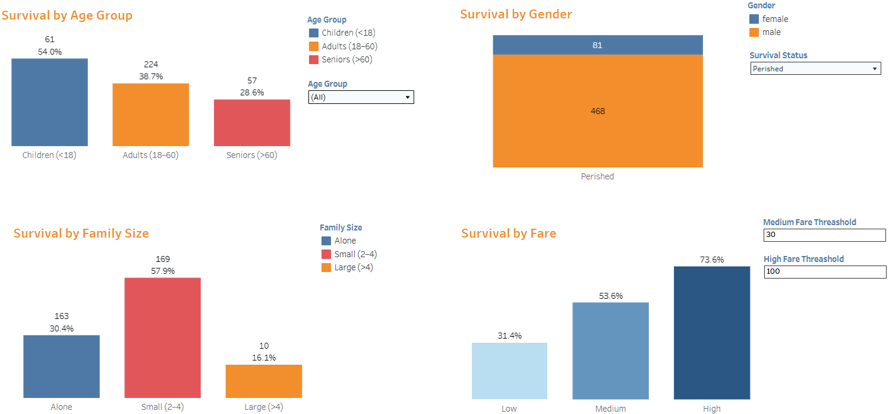
2.
Survival Analysis

Slide 13
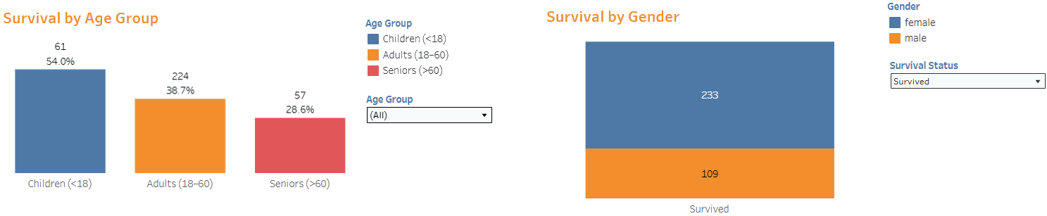
2.
Survival Analysis
Left Bar chart offers survived passenger age group breakdown: children, adults, seniors
Right Bar chart shows survived/perished passenger breakdown by gender
Children are displayed in blue, adults – in orange, seniors – in red
Most survived people were females (233)
Females are displayed in blue, males – in orange
Most survived passengers were adults (224). But children had the highest survival rate (54%).
Age Group dropdown allows filtering passengers based on whether they were children, adults or seniors
Survival Status filter allows viewing only survived or perished passengers by gender

Slide 14
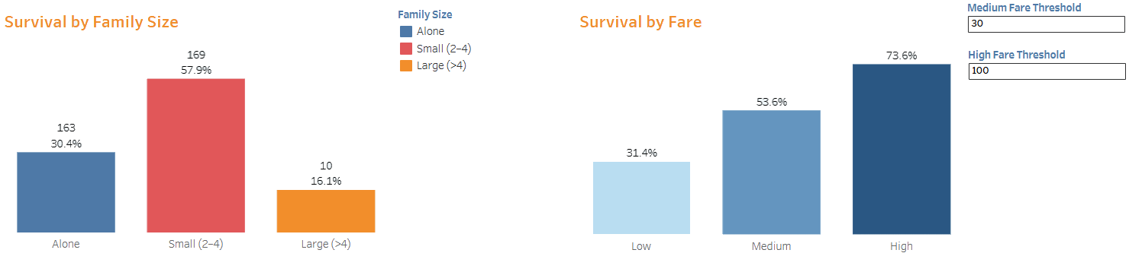
2.
Survival Analysis
Left Bar chart offers survived passenger family size breakdown: alone, small, large
Right Bar chart shows survived passenger breakdown by fare
Alone are displayed in blue, small – in red, large – in orange
People paid the highest fair survived the most (73%)
Mostly survived small families (169 people, almost 58%).
Low, medium and high fair bars are displayed in different shades of blue
Least survived large families (10 people, 16%).
Medium and Hire Fare Threshold boxes allow setting the range for low, medium and high fair

Slide 15
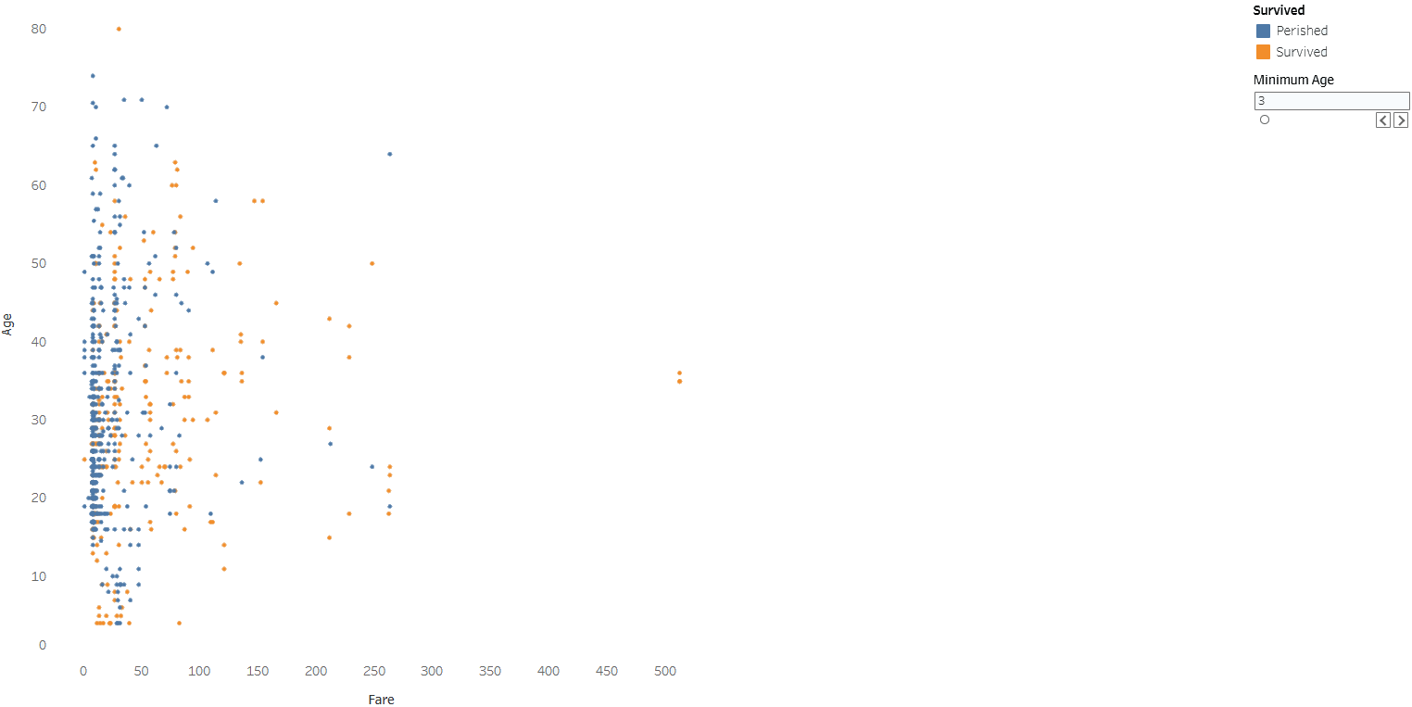
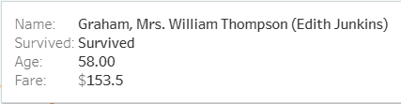

3.
Passenger Age & Fare Analysis
Scatterplot shows survived/perished passenger breakdown by age and fare
Age is Y axis (0 - 80 years), Fare – X axis ($0 - $500)
Perished passenger is displayed as a blue dot, survived – as an orange one
Most passengers paid up to $50 in fair and perished
Minimum Age filter allows setting the minimum age of displayed passengers on the scatterplot

Slide 16
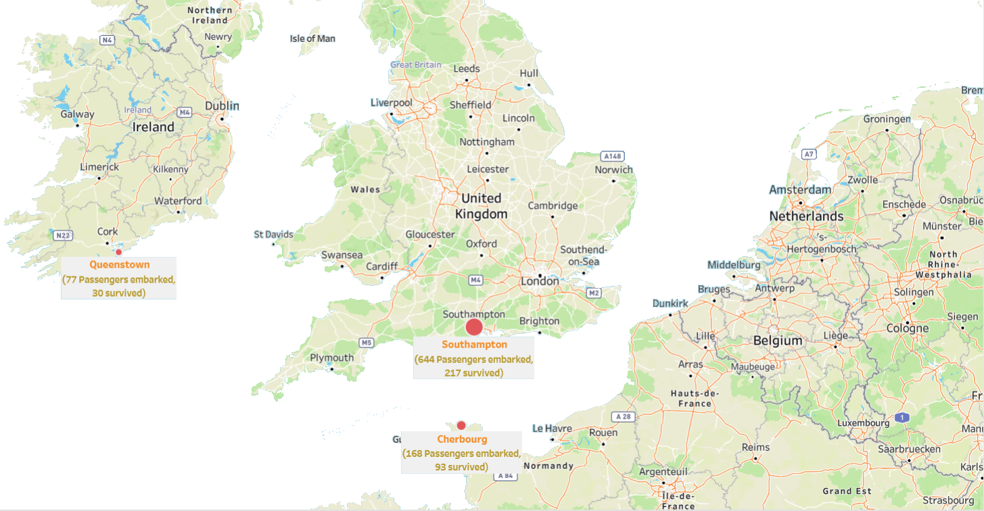
4.
Survivor Geography
Geographic visualization of embarkation port
Survival rates by embarkation location
Map-based analysis of passenger origin
Most passenger boarded at Southampton port (644). Out of those – 217 survived

Slide 17

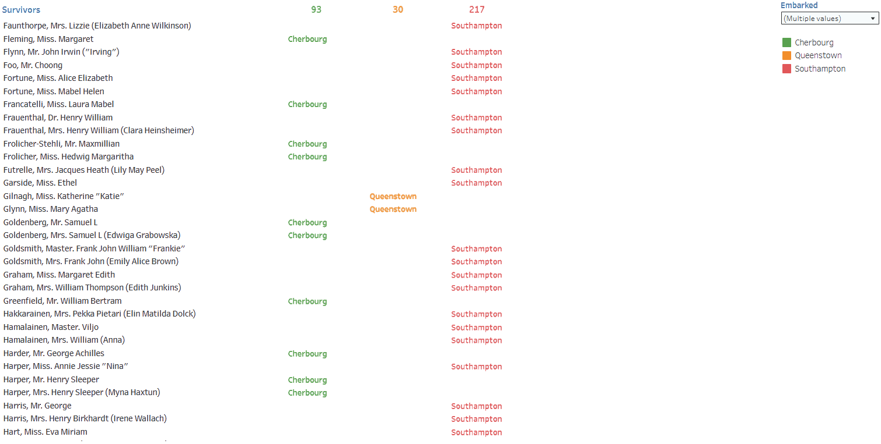
5.
Survivor List
Table shows list of survivors by embarkation port
Passengers boarded in Cherbourg are displayed in green, Queenstown – in orange, Southampton – in red
Most survived passengers boarded at Southampton (217)
Embarked filter allows viewing passengers by embarked port

Slide 18
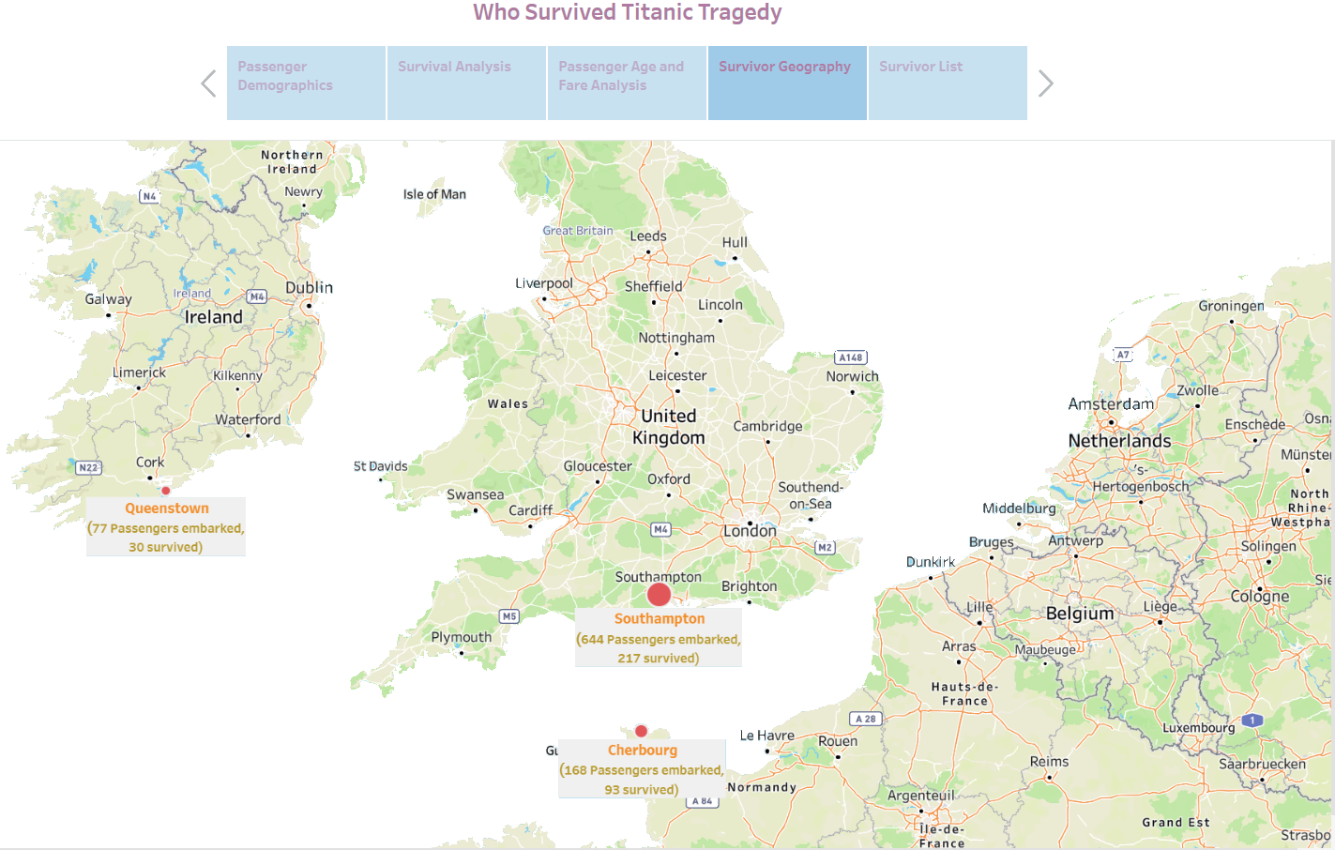
Titanic story offers easy navigation buttons and arrows

Slide 19



Thank
You
Vlad
Koval
Email - vkoval@gmail.com
Website - https://koval-vlad-portfolio.vercel.app/
Projects - https://github.com/koval-vlad
Profile - https://www.linkedin.com/in/vlad-koval-614976a4/
Please keep this slide for attribution.

